Slide 1
Module 15: Bridging to Certification
AWS Academy Cloud Architecting
Notes:
Welcome to Module 15: Bridging to Certification.

Slide 2

Module overview
Sections
Certification exam resources
Additional resources
Notes:
This module includes the following sections:
Certification exam resources
Additional resources

Slide 3
Module objectives
At the end of this module, you should be able to:
Identify how to prepare for the AWS Certified Solutions Architect - Associate exam
Identify where to find resources
Notes:
At the end of this module, you should be able to:
Identify how to prepare for the AWS Certified Solutions Architect - Associate exam
Identify where to find resources

Slide 4
Section 1: Certification exam resources
Module 15: Bridging to Certification
Notes:
Introducing Section 1: Certification exam resources.

Slide 5

Certification exam domain 1 objectives
Domain 1: Design Resilient Architectures (30%)
1.1 Design a multi-tier architecture solution
1.2 Design highly available and/or fault-tolerant architectures
1.3 Design decoupling mechanisms using AWS services
1.4 Choose appropriate resilient storage
Notes:
Domain 1 of the AWS Certified Solutions Architect - Associate examination is Design Resilient Architectures. It is 30 percent of the exam and covers the following objectives:
1.1 Design a multi-tier architecture solution
1.2 Design highly available and/or fault-tolerant architectures
1.3 Design decoupling mechanisms using AWS services
1.4 Choose appropriate resilient storage
This information can be found in the exam guide.

Slide 6
Certification exam domain 2 objectives
Domain 2: Design High-Performing Architectures (28%)
2.1 Identify elastic and scalable compute solutions for a workload
2.2 Select high-performing and scalable storage solutions for a workload
2.3 Select high-performing networking solutions for a workload
2.4 Choose high-performing database solutions for a workload
Notes:
Domain 2 of the AWS Certified Solutions Architect - Associate examination is Design High-Performing Architectures. It is 28 percent of the exam and covers the following objectives:
2.1 Identify elastic and scalable compute solutions for a workload
2.2 Select high-performing and scalable storage solutions for a workload
2.3 Select high-performing networking solutions for a workload
2.4 Choose high-performing database solutions for a workload
This information can be found in the exam guide.

Slide 7
Certification exam domain 3 objectives
Domain 3: Design Secure Applications and Architectures (24%)
3.1 Design secure access to AWS resources
3.2 Design secure application tiers
3.3 Select appropriate data security options
Notes:
Domain 3 of the AWS Certified Solutions Architect - Associate examination is Design Secure Applications and Architectures. It is 24 percent of the exam and covers the following objectives:
3.1 Design secure access to AWS resources
3.2 Design secure application tiers
3.3 Select appropriate data security options
This information can be found in the exam guide.

Slide 8
Certification exam domain 4 objectives
Domain 4: Design Cost-Optimized Architectures (18%)
4.1 Identify cost-effective storage solutions
4.2 Identify cost-effective compute and database services
4.3 Design cost-optimized network architectures
Notes:
Domain 4 of the AWS Certified Solutions Architect - Associate examination is Design Cost-Optimized Architectures. It is 18 percent of the exam and covers the following objectives:
4.1 Identify cost-effective storage solutions
4.2 Identify cost-effective compute and database services
4.3 Design cost-optimized network architectures
This information can be found in the exam guide.

Slide 9
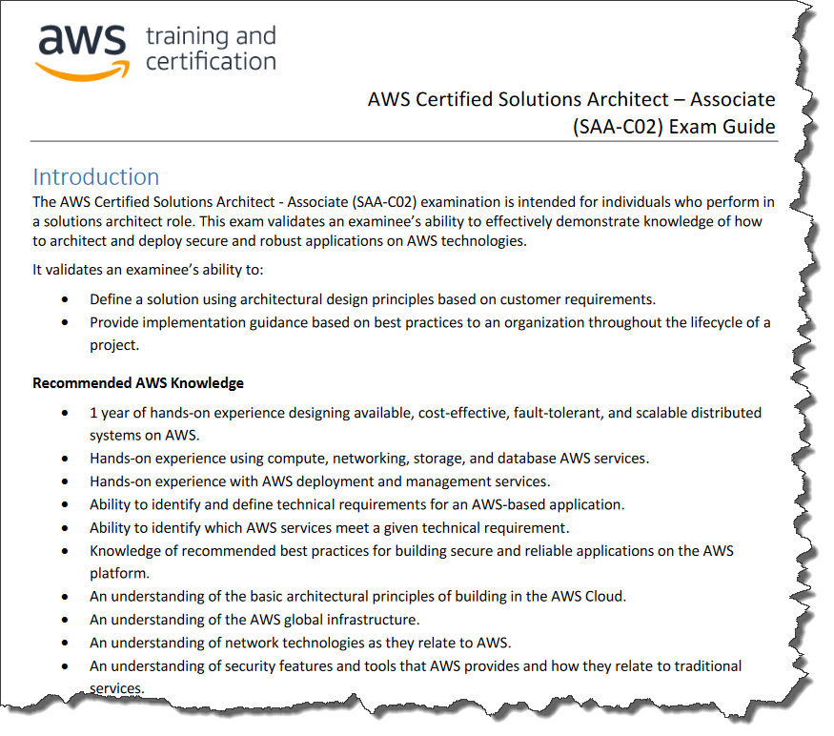
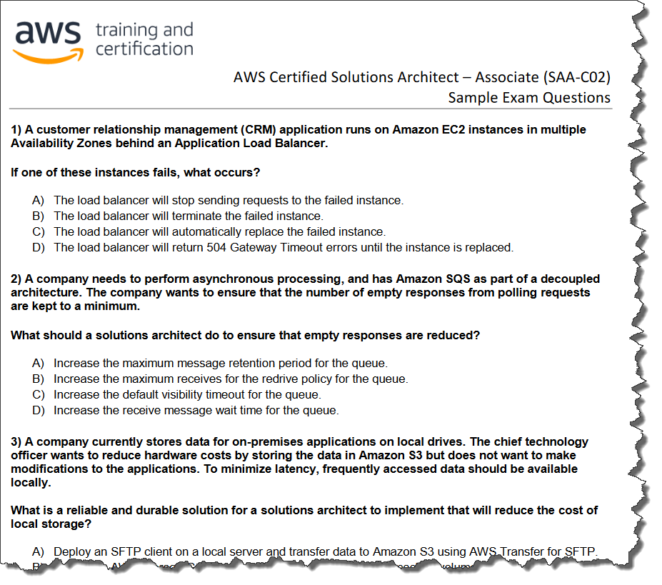
Exam guide and sample questions
Exam Guide
Sample Exam Questions
Notes:
Review the Exam Guide, which contains the content outline and target audience for the certification exam.
Perform a self-assessment to identify your knowledge or skills gaps. AWS offers Sample Exam Questions for the AWS Certified Solutions Architect - Associate exam.

Slide 10

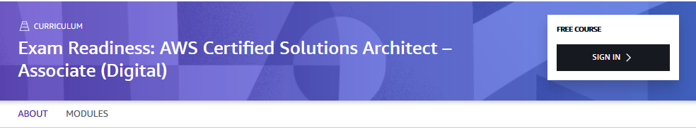
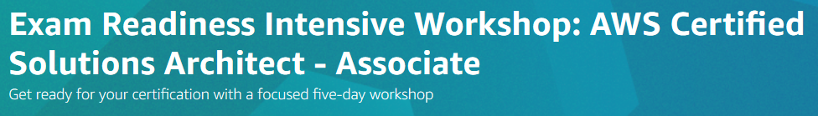
Exam readiness training
Notes:
AWS also offers Exam Readiness: AWS Certified Solutions Architect - Associate training in classroom and free digital training formats. This training helps you prepare for the AWS certification exam. AWS develops the training so that the content is current with the newest best practices. The training teaches you how to interpret exam questions and allocate your study time. It also reviews sample exam questions in each topic area. It teaches you how to interpret the concepts that are tested so that you can more easily eliminate incorrect responses.
There is also a 5-day, instructor-led Exam Readiness Intensive Workshop that can help you prepare for the exam.

Slide 11
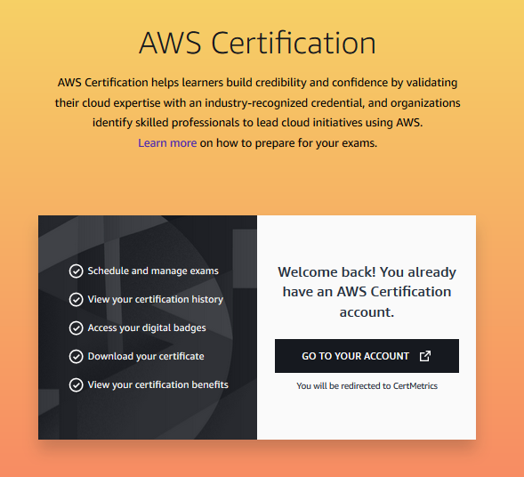
Practice exam
Register at AWS Training
Notes:
When you are ready, you can register to take a practice exam at AWS Training. The practice exam supplements the exam guide and helps you test your knowledge before you take the final exam.

Slide 12
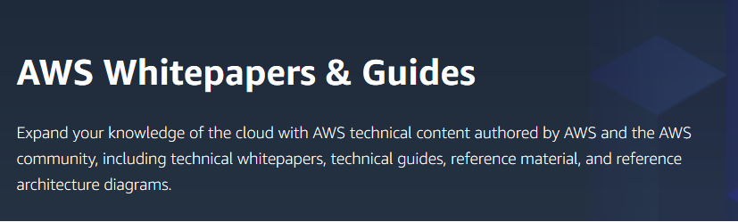
AWS whitepapers and guides
AWS Whitepapers & Guides website
Notes:
It’s a good idea to broaden your technical understanding by reading whitepapers and other technical content. AWS, independent analysts, and AWS Partner Network (APN) Partners create many of these helpful resources.
You can find whitepapers, technical guides, reference material, and architecture diagrams on the AWS Whitepapers & Guides website.

Slide 13
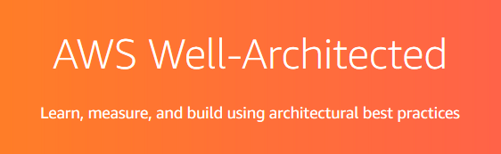







AWS Well-Architected Framework
Read the AWS Well-Architected Framework and Pillar whitepapers
AWS Well-Architected Framework website
Framework
Security
Operational Excellence
Reliability
Performance Efficiency
Cost Optimization
Sustainability
Notes:
To prepare for the AWS Certified Solutions Architect - Associate exam, focus on reading the whitepapers for the AWS Well-Architected Framework and each of the Pillars:
AWS Well-Architected Framework whitepaper
Security Pillar whitepaper
Operational Excellence Pillar whitepaper
Reliability Pillar whitepaper
Performance Efficiency Pillar whitepaper
Cost Optimization Pillar whitepaper
Sustainability Pillar whitepaper

Slide 14
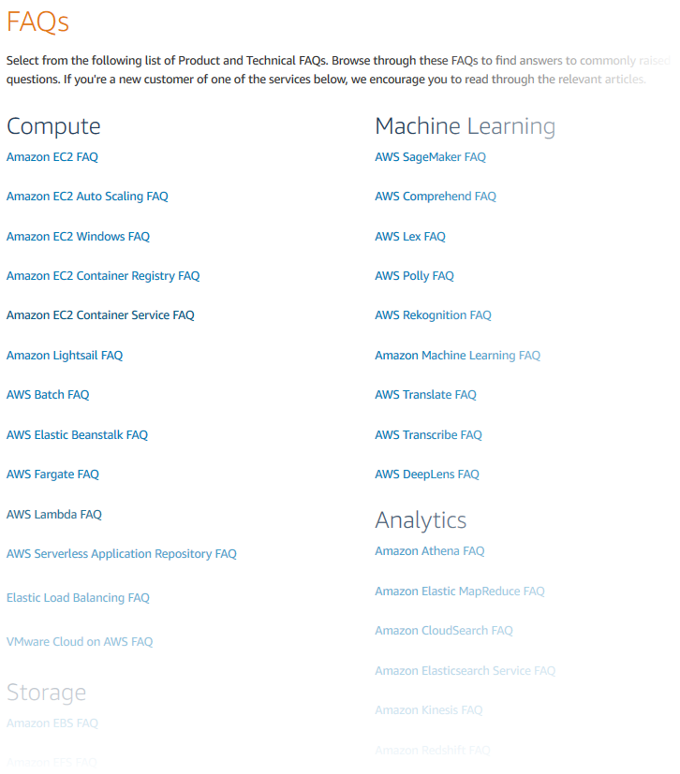
AWS frequently asked questions
Review the FAQs for:
Amazon EC2
Amazon S3
Amazon VPC
Amazon Route 53
Amazon RDS
Amazon SQS
AWS FAQs website
Notes:
Browse the product and technical frequently asked questions (FAQs) to familiarize yourself with commonly raised questions and issues.
Be sure to review the following FAQs:
Amazon Elastic Compute Cloud (Amazon EC2)
Amazon Simple Storage Service (Amazon S3)
Amazon Virtual Private Cloud (Amazon VPC)
Amazon Route 53
Amazon Relational Database Service (Amazon RDS)
Amazon Simple Queue Service (Amazon SQS)

Slide 15
Section 2: Additional resources
Module 15: Bridging to Certification
Notes:
Introducing Section 2: Additional resources.

Slide 16
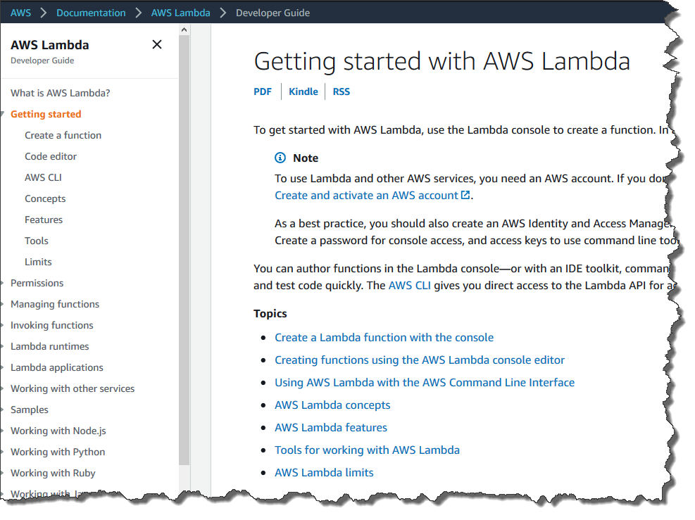
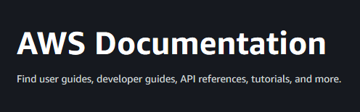
AWS Documentation
AWS Documentation website
Notes:
You can find user guides, developer guides, API references, tutorials and projects, SDKs and toolkits, and various other general resources in the AWS Documentation.
The AWS service developer guides contain a Getting started section with step-by-step tutorials that can help familiarize you with the services.

Slide 17
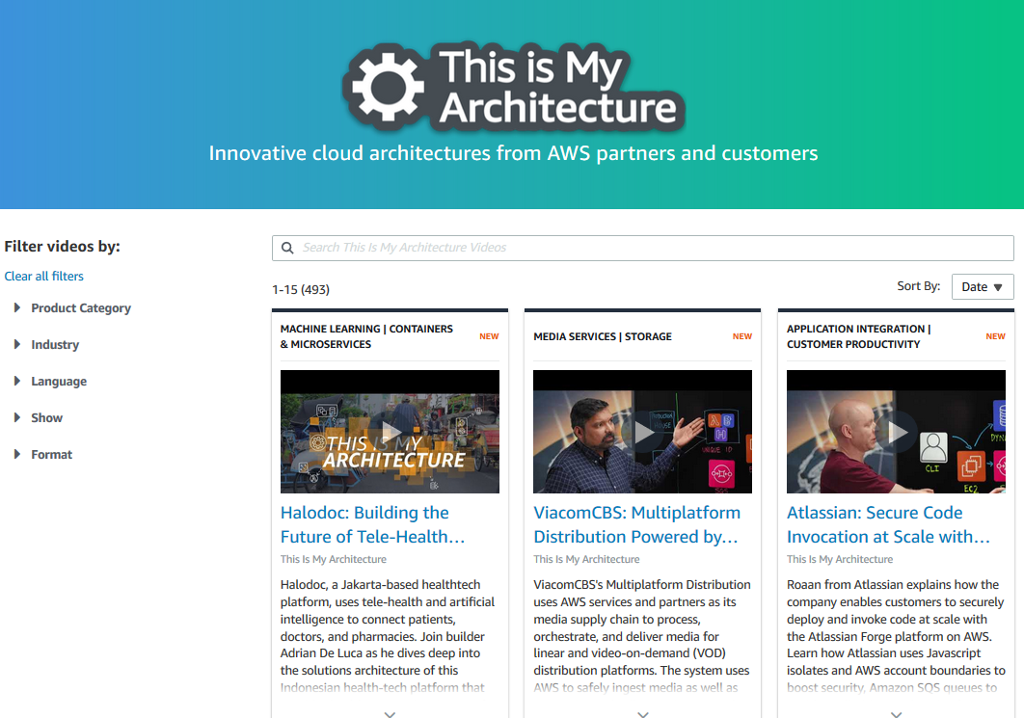
This is My Architecture video series
This is My Architecture website
Notes:
This is My Architecture is a video series that can help you learn about the innovative cloud architectures that APN Partners and customers have built.

Slide 18
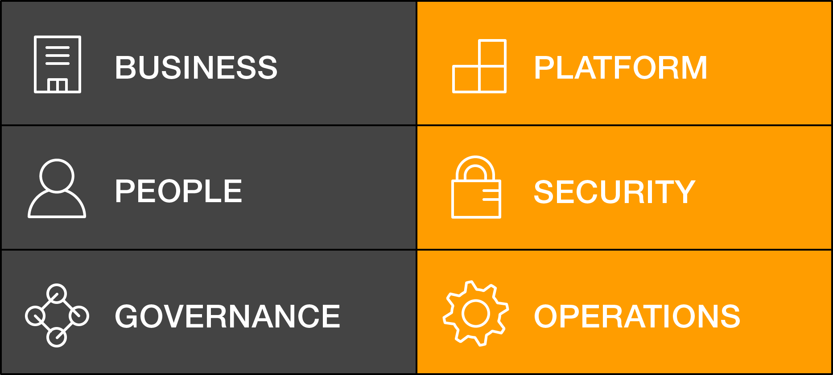
AWS Cloud Adoption Framework
Provides guidance and best practices to help organizations build a comprehensive approach to cloud computing
Can be used across the organization and throughout the IT lifecycle to accelerate successful cloud adoption
Is organized into six perspectives that consist of sets of capabilities
AWS CAF perspectives
AWS Cloud Adoption Framework website
Notes:
Each organization’s cloud adoption journey is unique. However, for any organization to successfully migrate its IT portfolio to the cloud, three elements (people, process, and technology) must be in alignment. Business and technology leaders in an organization must understand the organization’s current state, target state, and the transition necessary to achieve the target state. In this way, they can set goals and create processes for staff.
The AWS Cloud Adoption Framework (AWS CAF) provides guidance and best practices to help organizations identify gaps in skills and processes. It also helps organizations build a comprehensive approach to cloud computing—both across the organization and throughout the IT lifecycle—to accelerate successful cloud adoption.
At the highest level, the AWS CAF organizes guidance into six areas of focus, called perspectives. Perspectives span people, processes, and technology. Each perspective consists of a set of capabilities, which covers distinct responsibilities that functionally related stakeholders own or manage.
Capabilities within each perspective are used to identify which areas of an organization require attention. By identifying gaps, prescriptive work streams can be created that support a successful cloud journey.

Slide 19
There’s no substitute for hands-on experience.
Notes:
When you are preparing for the AWS Certification exam, it’s important to remember that hands-on experience has no substitute. Before you take an AWS Certification exam, AWS recommends that you have hands-on experience with relevant AWS products and services. AWS offers various resources to help you gain hands-on experience with AWS services.

Slide 20
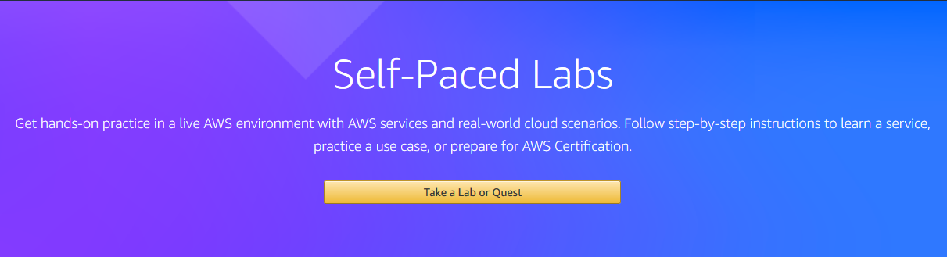
Self-Paced Labs
Self-Paced Labs website
Notes:
Self-paced labs are a way for you to get hands-on practice with AWS services and real world-cloud scenarios in a live AWS environment.
You can:
Take an individual lab to get familiar with an AWS service.
Follow a learning quest that will lead you through a sequence of labs so that you can learn how to work with related AWS services. When you complete a quest, you will earn a Quest Badge that you can display on your resume, website, or LinkedIn profile.
For more information about self-paced labs, see the Self-Paced Labs website.

Slide 21
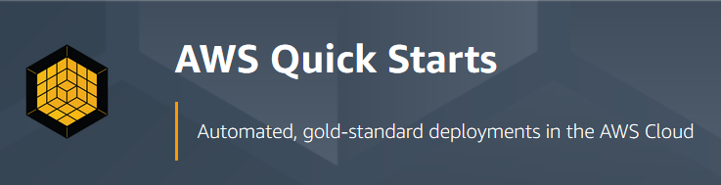
AWS Quick Starts
AWS Quick Starts website
Notes:
AWS solutions architects and partners build Quick Starts to help you deploy popular technologies on AWS. These technologies are based on AWS best practices for security and high availability. These accelerators reduce hundreds of manual procedures into a few steps, so you can build your production environment quickly and start to use it immediately.
Each Quick Start includes AWS CloudFormation templates that automate the deployment and a guide that discusses the architecture and provides step-by-step deployment instructions.
For more information, see AWS Quick Starts.

Slide 22
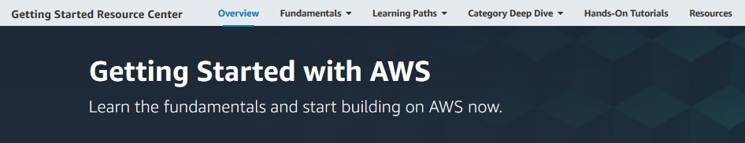
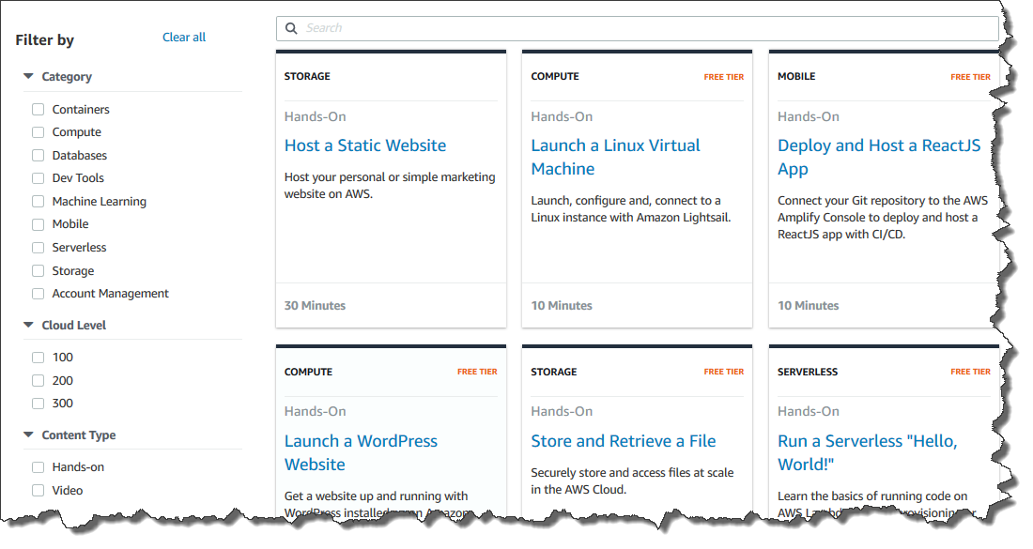
Getting Started tutorials
Getting Started with AWS website
Notes:
Getting Started hands-on tutorials and learning paths help you learn the fundamentals of AWS and start building on AWS right away.

Slide 23

Optional course capstone project
Notes:
The capstone project is one way to practice applying the knowledge that you have developed in the course to a real-world scenario. By completing and documenting the project, you will have an asset that you can add to your portfolio of work for future opportunities.

Slide 24

Capstone project: Customer requirements
Provide secure hosting of the MySQL database
Provide secure access for an administrative user
Provide anonymous access to web users
Run the website on a t2.small EC2 instance, and provide Secure Shell (SSH) access to administrators
Provide high availability to the website through a load balancer
Store database connection information in the AWS Systems Manager Parameter Store
Provide automatic scaling that uses a launch template
Notes:
The requirements for the capstone project are:
Provide secure hosting of the MySQL database
Provide secure access for an administrative user
Provide anonymous access to web users
Run the website on a t2.small EC2 instance, and provide Secure Shell (SSH) access to administrators
Provide high availability to the website through a load balancer
Store database connection information in the AWS Systems Manager Parameter Store
Provide automatic scaling that uses a launch template

Slide 25
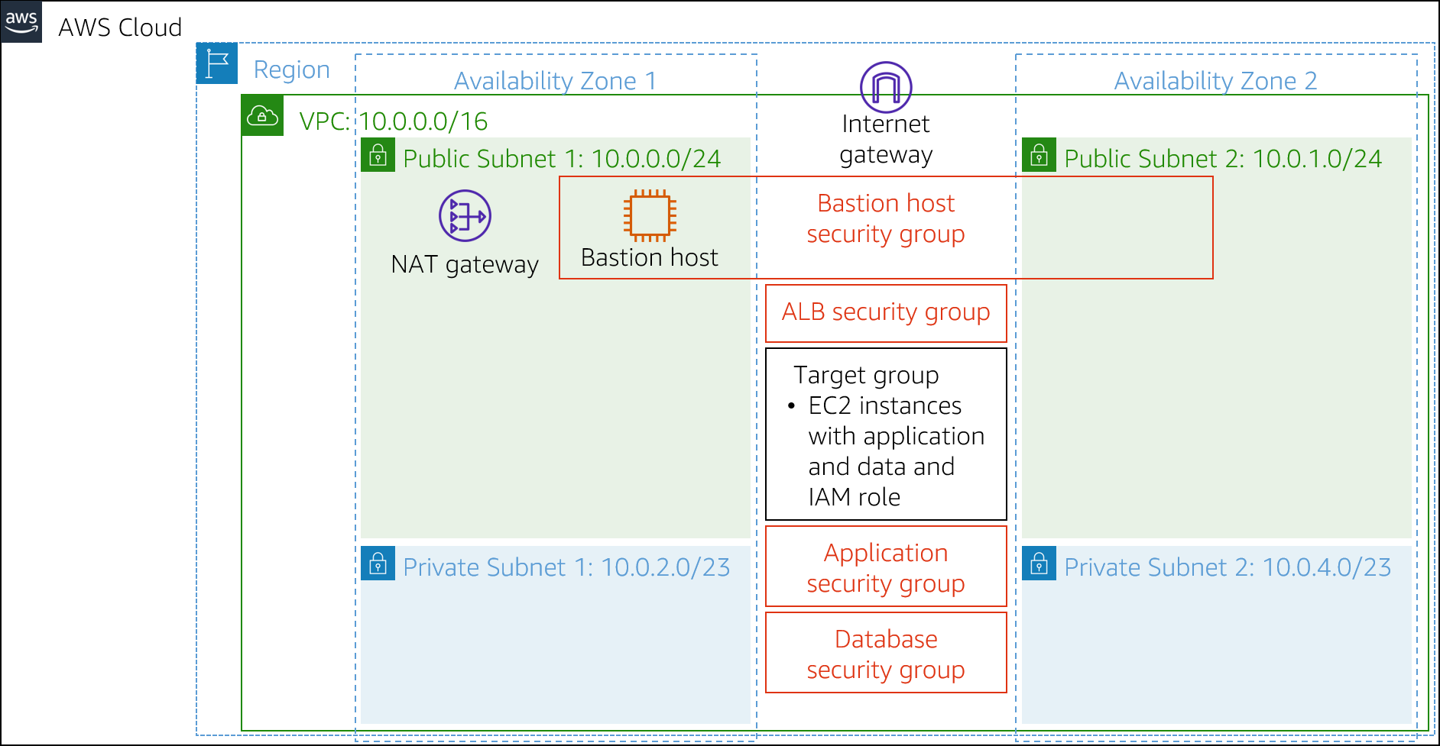
Capstone project: Resources
PHP code stored in a .zip file
MySQL dump file that contains the data
AWS resources that are displayed in the architecture diagram
Notes:
For the capstone project, a number of resources are provided to you. The diagram shows the resources that you will find when you log in to the development environment. The development environment is configured to maintain resources between sessions. Each session lasts 10 hours. In addition to the AWS resources, you have access to a .zip file that contains the PHP code for the website and a MySQL dump file that contains the data to store in the database.
For accessibility: Architecture diagram with VPC spread across two Availability Zones, where each Availability Zone has a public and private subnet. The public subnet in zone 1 has a NAT gateway and bastion host. The VPC has an internet gateway, application load balancer target group, and security groups for the bastion host, application load balancer, application servers, and database. End of accessibility description.

Slide 26
Module wrap-up
Module 15: Bridging to Certification
Notes:
It’s now time to review the module.

Slide 27
Module summary
In summary, in this module, you learned how to:
Identify how to prepare for the AWS Certified Solutions Architect - Associate exam
Identify where to find resources
Notes:
In summary, in this module, you learned how to:
Identify how to prepare for the AWS Certified Solutions Architect - Associate exam
Identify where to find resources

Slide 28
Thank you
Corrections, feedback, or other questions? Contact us at https://support.aws.amazon.com/#/contacts/aws-academy. All trademarks are the property of their owners.
Notes:
Thank you for completing this module.

